Slide 1
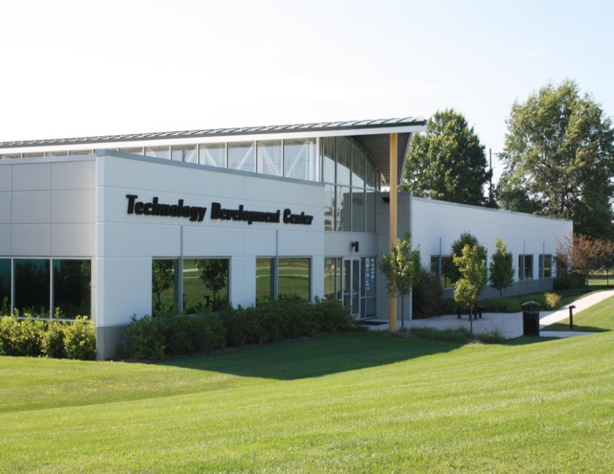
Intellectual Property Committee Report to Faculty Senate, January 2019
With Assistance From
Office of Technology Transfer and Economic Development
ecodevo.mst.edu | businessdevelopment.mst.edu | techtransfer.mst.edu

Slide 2
Results (FY18)
Technology Transfer
Royalty Income
Second Highest Income $530K (FY17 revised up to $559K)
Patents/Copyrights Issued
8
Disclosures Received
50 record number
Active License/options
32 Licenses
3 pending
Active Case load
181 cases
Patent expenses
$351K total patent expenses
$235K unreimbursed
$108K repaid by licensee
Snap Shot (FY19 through November)
Disclosure = 20
Royalty Income to date = $247K
Patents/Copyrights filed = 14
Patents/Copyrights Issued/Allowed = 6

Slide 3
TTO Comparable Schools
Metric 3 year average | S&T | Colorado Mines | Michigan Tech | New Jersey Tech | Georgia Tech
Invention Disclosures | 47 | 50 | 35 | 44 | 293
Disclosure/Research | 1.28 | 0.84 | 0.49 | 0.34 | 0.38
License Income | $519,000 | $97,000 | $272,000 | $87,000 | $1,587,000
License income/Research | $14,048 | $1,590 | $3,820 | $687 | $2,047
Patents Issued | 10 | 10 | 3 | 22 | Not reported
Source: 2017 AUTM STATT Database

Slide 4
Opportunities/Challenges
New Express License approved for faculty start-ups
New TTED funding to support early stage technology development
Diverse Royalty Income base
Strong partnerships with our licensees/corporate partners
Invention disclosures remain high (FY18 record 50 new disclosures) – extensive outreach

Slide 5
Opportunities/Challenges
Constant concern about “centralization” of TT function – shared services
System Patent budget is a concern
Non-Royalty producing Technology Transfer increasing
Consortium developed inventions – NERF, patent costs covered
“Sponsor owns the IP” inventions – Upcharge now 20% and ¼ of that now flows to TT to support commercialization grants

Slide 6
Bayh Dole Changes
Recent changes to the Bayh-Dole regulations now effectively require a written assignment to be in place before conducting any work on a federally funded project. Thus, this written invention assignment agreement is an effort for University campuses to remain in compliance with its federally funded contracts and the Bayh-Dole regulations.

Slide 7
Changes to 37 C.F.R. § 401.14(f)(2)
The contractor agrees to require, by written agreement, its employees, other than clerical and nontechnical employees, to disclose promptly in writing to personnel identified as responsible for the administration of patent matters and in a format suggested by the contractor each subject invention made under contract in order that the contractor can comply with the disclosure provisions of paragraph (c), above of this clause, to assign to the contractor the entire right, title and interest in and to each subject invention made under contract and to execute all papers necessary to file patent applications on subject inventions and to establish the government's rights in the subject inventions.

Slide 8
Concerns Raised by MyHR Invention Assignment Agreement
The new agreement does not clearly delineate the fact that this condition only applies to federally-funded research.
The language of the further assurances clause differs significantly from prior agreements that have been through faculty governance.
The roll-out process did not develop the trust needed for good faith execution.
An FAQ was written, but did not actually answer any of the questions raised.

Slide 9
MyHR
You hereby assign, transfer and convey to the University your entire right, title and interest in and to each invention made within the general scope of your duties with the University.
You agree to execute any and all assignments and other documents that may be needed to record, vest or perfect University’s right, title and interest in and to such inventions and to establish government's rights in the inventions. You agree to execute any and all declarations, oaths, specifications and other papers or documents requested by the University in connection with the filing or prosecution directed to University owned inventions.
Invention Disclosure
I acknowledge and agree that I am required to assign to the University all domestic and foreign rights to any invention made by me within the general scope of my duties as an employee of the University. I hereby assign to The Curators of the University of Missouri all my rights in the invention disclosed herein, including any domestic and foreign patent applications related thereto, and I agree to sign such documents as may be required for this purpose, including but not limited to an assignment of the invention to the University in a form that may be recorded, a declaration as to inventorship, and power of attorney.
University Assignment
Assignors hereby assign, transfer, and convey (and confirm any prior such conveyance as the case may be) to Assignee, the invention disclosed and/or claimed, in whole or in part, in the Patent Application and any and all improvements therein conceived or reduced to practice by each of Assignors in the course of and the general scope of each of Assignors’ employment with Assignee.
Upon the reasonable request of Assignee, Assignors agree to execute such documents and perform such acts as may be necessary to give full effect to the terms of this Agreement. Without limiting the generality of the foregoing, Assignors agree to execute any and all assignments and other documents that may be needed to record, vest, or perfect Assignee's right, title, and interest in and to the Assigned Rights as fully and entirely as the same would have been held and enjoyed by Assignors if this assignment had not been made.

Slide 10
The IP committee moves that the Faculty Senate approve the following resolution:
The Faculty Senate of the Missouri University of Science and Technology acknowledges the additional requirements imposed by changes to 37 C.F.R. § 401.14(f)(2), which require a written agreement prior to the execution of federally-funded research. However, we cannot advise faculty to execute the agreement that has been implemented via MyHR in August 2018. We request the following actions of the Vice President of Research and Economic Development at the University of Missouri System:
That the language in the agreement be changed to explicitly restrict applicability to federally-funded research;
That the language in the agreement be changed to mirror existing language in the invention disclosure (Form UM 16C rev. 09.15.15), particularly in regards to the further assurances clause;
That a different process be used so that the agreement is tied to specific federal grants and contracts, rather than as a blanket statement with indeterminate applicability; and
That the UM System Patent Committee, at a minimum, be involved in all further matters regarding the Bayh-Dole Act and its changes.

Slide 11
References
Existing invention disclosure available at: https://ecodevo.mst.edu/media/center/ecodevo/documents/Form_Disclosure_Invention_UM16C_09.15.15_MST.doc
VP Research and Economic Development: https://www.umsystem.edu/ums/red
FAQ available at: https://www.umsystem.edu/ums/red/oipa/bayh-dole-faqs

